Slide 1
Chapter 10 & 11
Rotational Motion About
a Fixed Axis
Torque, Rotational Inertia and Law
Work and Rotational Kinetic Energy
Rolling
Angular Momentum and Conservation of Angular Momentum

Slide 2





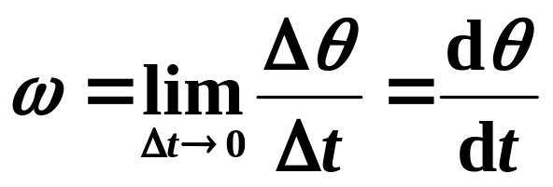
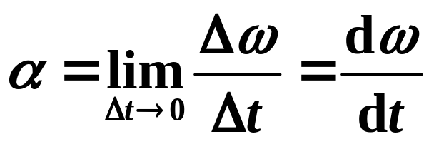
10-1. Angular Quantities (P235)
1. Angular variables
y
Angular displacement(角位移):
Angular velocity :
O
x
(radian measure)
Angular acceleration :

Slide 3
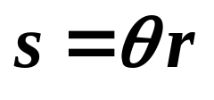
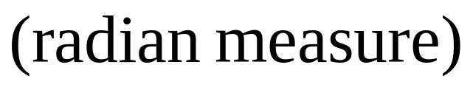
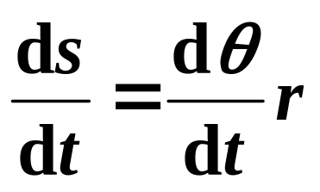

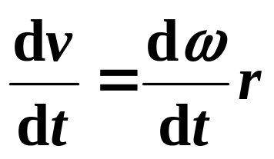
2. Relation of linear and angular variables
The distance along a circular arc:
The linear speed (with r held constant):
or
Differentiating above equation with respect to time (r again holds constant)

Slide 4
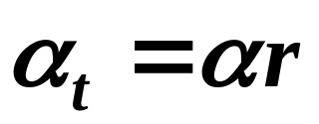
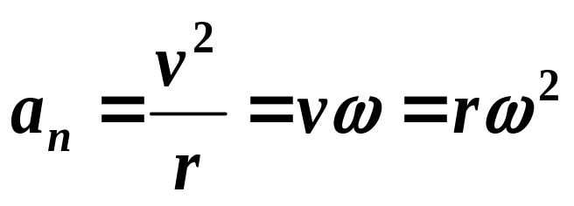
The tangential component a_{t} :
The radial component a_{n}:
They are valid only if angles are expressed in radian.
a_{n} is also called a_{R}, radial acceleration, in our book.

Slide 5


3. Kinematics equations for uniformly accelerated rotational motion (P238)
Equations of motion for constant linear acceleration are analogous to the ones of constant angular acceleration:
linear missing angular
equation variable equation
v = v₀ + at x -x₀
x - x₀ = v₀t + at² v
v² = v₀² + 2a(x - x₀) t
x - x₀ = (v₀ + v)t a
x - x₀ = vt - at² v₀
θ - θ₀ ω = ω₀ +αt
ω θ - θ₀ = ω₀t + αt²
t ω² = ω₀² +2α(θ -θ₀)
α θ - θ₀ = (ω₀ + ω)t
ω₀ θ - θ₀ = ωt - αt²

Slide 6
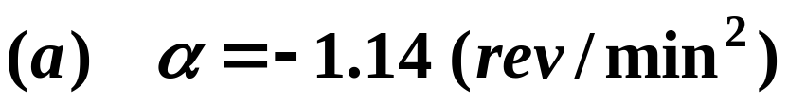
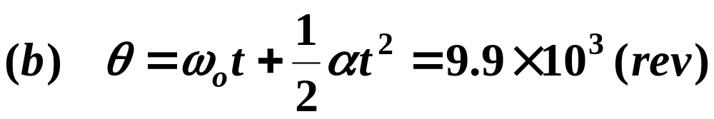
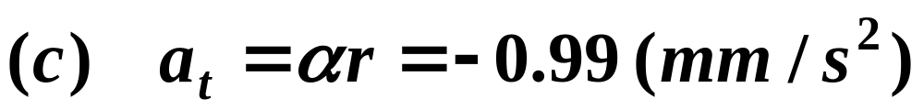
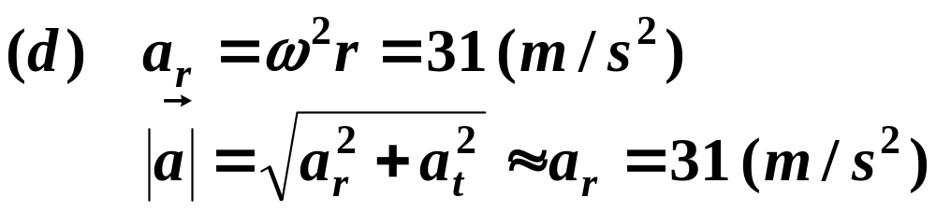
The flywheel of a steam engine runs with a constant angular velocity of 150rev/min. When steam is shut off, the friction of the bearings and of the air stops the wheel in 2.2h.
(b) How many rotations does the wheel make before stopping? (a) what is the constant angular acceleration, in rev/min², of the wheel during the slowdown?
(c) At the instant the flywheel is tuning at 75rev/min, what is the tangential component of the linear acceleration of a flywheel particle that is 50cm from the axis of rotation? (d) What is the magnitude of the net linear acceleration of the particle in (c)?
ANSWER:
Example:

Slide 7
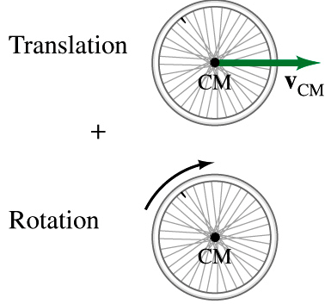
10-2 Several Concepts Related to Rotation
(a) A rigid body is one that can rotate with all its parts locked together and without any change in its shape (刚体是一种特殊的质点系统).
(b) The motion of a rigid body reduces to a translation of its center of mass adds a rotation relative to center of mass.

Slide 8
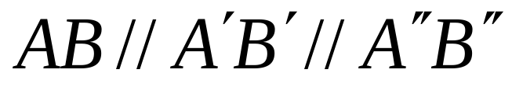
(c) Translation is motion along a straight line.
B''
A
B
A''
A'
B'
Feature：
(d) Rotation is the motion as the Fig. showing.
Feature：
p
Any point moves around one same axis.
rotation axis

Slide 9

The features of rotation about a fixed axis:
The location and direction of rotation axis are fixed relative to a inertial reference frame.
Every point of body moves in a circle whose center lies on rotation axis and radius different.
z
Each rotation plane is perpendicular to rotation axis.
A
Every point moves through the same angle during a particular time interval (各点的 Δ θ，ω，α 相同).
A′
B
B′

Slide 10
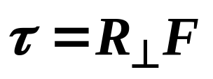
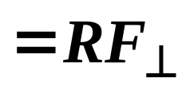
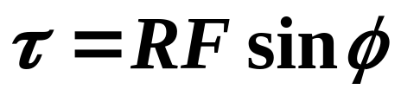

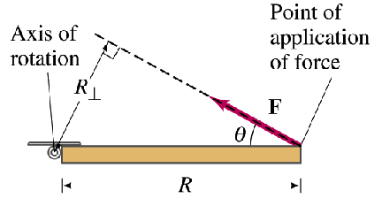
10-3 Torque and Rotational Inertia of Rigid bodies
1. Torque on an axis (对轴的力矩)
(P241)
The torque about a given axis is defined as:
or
where is called moment arm —— the distance
from the axis of rotation that is perpendicular to the line of action of the force.
Its SI units: m ⋅N

Slide 11




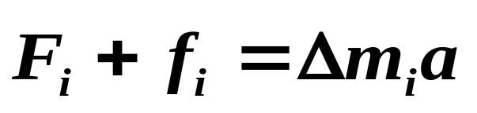




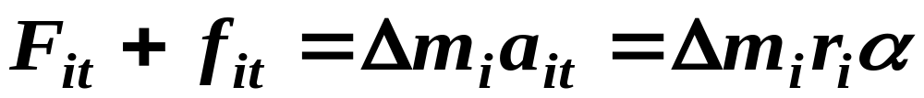
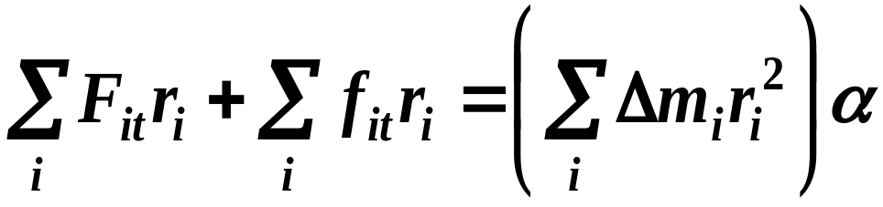
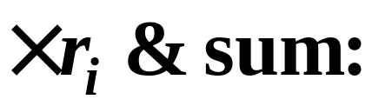

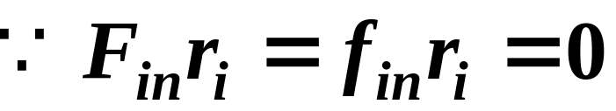
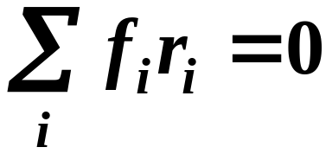
2. N-II law for rotation (定轴转动定律)
(P244)
A rotational rigid body can be considered to be constituted by many parts. The ith part has a mass Δm_{i ,}
external force ;
internal force
z
Applying N-II law on Δm_{i:}
O
Δm_{i}
Resolving it into directions and :
and

Slide 12
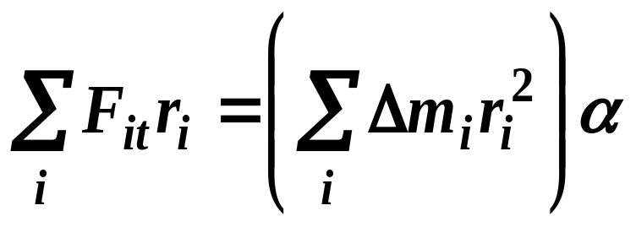
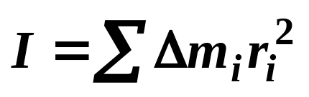
So, we have
Let
τ
=
∑
τ
=
∑
F
r
net
i
it
i
i
—— Net torque about given axis, and
—— the moment of inertia or rotational inertia (转动惯量) on the axis.
Then,
τ
=
I
α
N-II law for rotation
net
—— Net torque on a rigid body equals to the product of rotational inertia and angular acceleration it causes about same axis.

Slide 13
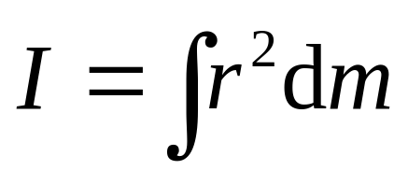
3. The rotational inertia of body (P248)
The moment of inertia I is a measure of the rotational inertia of a body, which plays the same role for rotational motion that mass does for translational motion.
For a continuous rigid body, the summation in the
rotational inertia can be substituted by an integral ,
⎧
ρ
dV
⎪
where,
dm
=
σ
dS
⎨
⎪
λ
⎩
dl

Slide 14
Descriptions：
1.
Rotational inertia is the measure for the inertia of rotation (转动惯量是转动惯性大小的量度). (kg·m²) In general, smaller I means easier rotation.
2.
It is determined by the total mass and the distribution of mass to the axis, so rotational inertia relative to different axis is different even for the same body.
3.
The rules for calculating rotational inertia:

Slide 15
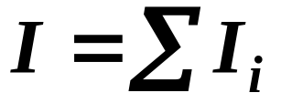
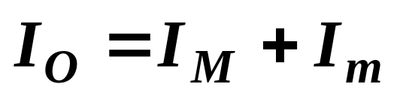

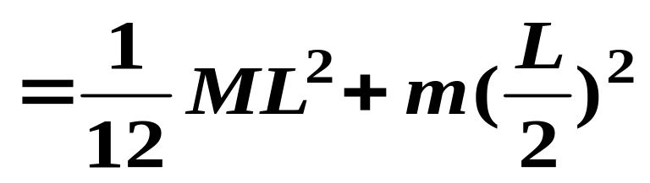
(1) For same axis, rotational inertia can be superimposed.
The I of a group-body to an same axis equals the sum of the one of every rigid body.
For the case shown in right figure: Thin rod plus a ball of particle,
O
M
m

Slide 16
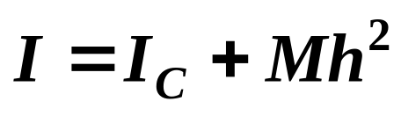
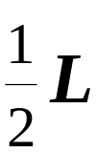
(2) Parallel-axis theorem
Let I_{c} be the rotational inertia of body with respect to the center of mass,
and h be the perpendicular distance between given axis and the axis through center of mass (these two axes must be parallel).
The rotational inertia I about the given axis is:
z
h
C
This is known as the
parallel-axis theorem.
Some rotational inertias in Fig.10-21 of P246:

Slide 17
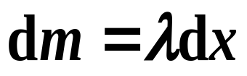
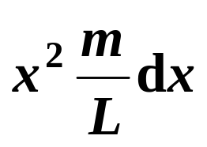

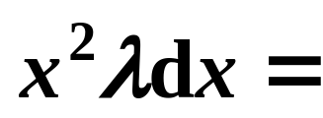
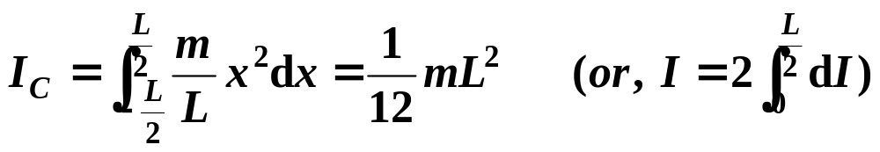

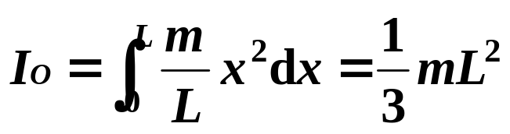
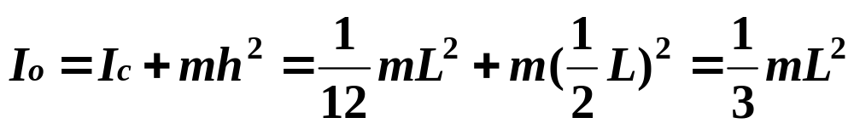
Example:
Try to find out I of a thin rod of mass m, length L to (1) C and (2) O axes.
Solution:(1)
C
x
x
Solution:(2)
x
O
x
L
From the parallel-axis theorem, we have I to O axis:

Slide 18
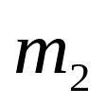
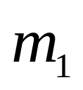
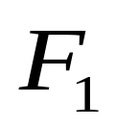


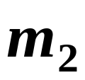




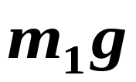
Example:
In the Fig. block A has mass m₁, B has m_{2.} (m₁ > m₂ ).Two pulleys (mounted together in horizontal frictionless bearings (轴承)) have rotational inertia I₁ and I₂. (neglect all friction forces and mass of cord, no slide). Find: (1) The acceleration of A and B; (2) The tension of cord.
R
c
r
B
A
Solution:
o
c
A
B

Slide 19
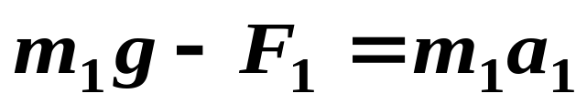
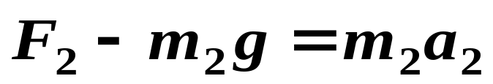
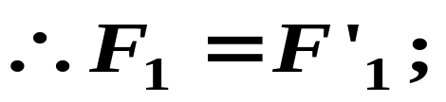
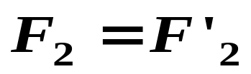
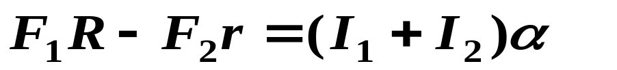
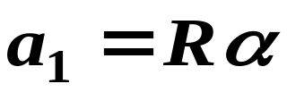
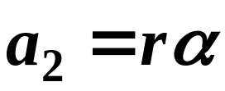




Neglect the mass of cord,
A
o
c
B

Slide 20




10-4 Rotational Kinetic Energy (P254)
1. The kinetic energy of rotation
A body rotating about an fixed axis is said to have rotational kinetic energy. By analogy with translational kinetic energy, we have
Using equation of I,
then,

Slide 21









2. Work-kinetic energy theorem for fixed-axis rotation
From the kinetic theorem of a single particle,
One can guess
for a rotation
Proof:

d
❑
O

Slide 22



So, we get the work-kinetic energy theorem for rigid body rotated about a fixed axis:
where
—– the work done on a rigid body during a finite angular displacement equals to the change of its rotational kinetic energy.
By analogy,
—– the power for rotational motion

Slide 23




3.Work-energy principle for fixed-axis rotation
The principle of work-energy for particle-systems is still hold for the rigid bodies.
The weight-energy of rigid body:
Δ
m_{i}
C
×
h_{C}
h_{i}
刚体的重力势能与它的质量集中在质心时的势能相同
U=0

Slide 24


Example:
As in the Fig. : For the spring, k=2.0×10³ N/m.
k
For the wheel, I=0.5 kg .m² , R=30cm.
R
What is the speed of the body (m=60kg), when it falls 40cm.
m
Initially, it is at rest and the spring is not stretched.
Solution:
mg
−
F
=
ma
FR
−
kxR
=
I
α

Slide 25









or,

Slide 26

10-5 Rolling; Rotational + Translational Motion
(P256)
1. Two ways to express rolling motion
(1) The rolling motion of a wheel is a combination of purely translation and purely rotational motions:
Top Fig.: purely translational motion with linear speed v_{cm};
Middle: pure rotation around the axis, every point on the wheel rotates about the center with angular speed ω.
Bottom: actually rolling motion of wheel.

Slide 27


(2) Rolling as pure rotation:
At any moment, the point P is stationary with linear speed v_{P}=0, it can be considered as an axis, and the rolling motion of the wheel
as a pure rotation about this axis.
The point P can be referred to as an instantaneous axis.
2. The kinetic energy rolling
The kinetic energy of rolling about the point P is:

Slide 28

From the parallel-axis theorem,
I
=
I
+
MR
2
P
com
where I_{com} is the rotational inertia about an axis through its center of mass. So the kinetic energy of the rotation is
1
1
∴
K
=
I
ω
2
+
Mv
2
2
com
2
com
A rolling object has two types of kinetic energy:
A rotational K due to its rotation about its center of mass and translational K due to translation of its center of mass.

Slide 29



Analysis of a sphere on an incline using forces. The mass of the sphere is M, and the radius is R.
F
−
Mg
cos
θ
=
0
;
N
Mg
sin
θ
−
F
=
Ma
;
fr
F
R
=
I
α
fr
cm
For the case “rolling smoothly”, we have
a
It is suitable for the linear of any body rolling along an incline of θ with the horizontal.
com
,
x

Slide 30



For a sphere,
Then,
It is independent of mass and radius!
The acceleration of the CM of a rolling sphere is less than that for an object sliding without friction (a=gsinθ ).
2
2
(
)
I
α
MR
a
/
R
F
=
cm
=
5
fr
R
R
This is the minimum static friction force to keep pure rolling. If a static friction force μMgcosθ < this value, then the sphere will not simply roll but slip as it moves down the plane.

Slide 31


The speed v at the bottom is:
Two conditions given by the rolling smoothly:
(1) f on the ball from the ramp does not transfer any energy to thermal energy because the body does not slide;
(2) v=Rω and a = Rα are valid.

Slide 32




10-6 Angular Momentum and Torque for a System of Particles; General Motion (P278)
1. Torque about a point
The torque acting on a particle relative to a fixed point O is a vector quantity defined as:
where is the position vector of a particle relative to O, and the total torque τ
on a system of particles will be:

Slide 33


Note:
(i) Where is the position vector of the ith particle and is the net force on the ith particle.
(ii) This definition is for particles moving along any path relative to a fixed point.
(iii) That point must always be specified if the value of the torque is to be meaningful. Changing the point can change the torque in both magnitude and direction.

Slide 34



2. Angular momentum of a particle
The linear momentum of a particle:
❒
❒
p
=
m
v
The Angular momentum relative to a fixed point：
Magnitude:
×
Direction：right-hand rule

Slide 35



Supplementary explanation:
(1) It is a vector quantity (SI unit: J.s);
(2) It is not same relative to different point.
(3) The angular momentum of particle relative to some point in the motion of straight line.
⊗
m
大小：
d
=
mvd
Direction:
⊗
O

Slide 36

3. Relation between angular momentum and torque
In linear motion, we have Newton’s second law for a single particle:
❒
one can guess for its angular form
❒
d
l
τ
=
.
net
dt
The rotational equivalent of N-II law for a particle.
The time rate of change of angular momentum of a particle is equal to the net torque applied to it.

Slide 37

4. The angular momentum of a system of particles
For a system of particles, total angular momentum of the system is the (vector) sum of the angular momentum of the individual particles :
❒
l
❒
❒
❒
❒
n
❒
L
=
l
+
l
+
· · ·
+
l
=
∑
l
1
2
n
i
i
=
1
If the angular momenta of individual particles change with time, then we have
❒
❒
d
L
n
d
l
n
❒
=
∑
i
=
∑
τ
.
dt
dt
net
,
i
❒
i
=
1
i
=
1
❒
d
l
τ
=
i
is the net torque acting on the ith particle.
net
,
i
d
t

Slide 38



Total net torque acting on all particles of system
angular momentum principle
(质点系角动量定理)
The time rate of change of the total angular momentum of a particle’s system (or a rigid body) equals resultant external torque on the system.
❒
❒
d
p
(~
F
=
)
It can also be written as:
dt
Note:
It is true only when and are calculated with respect to either (1) the origin of an inertial RF or (2) the center of mass of a particle’s system.

Slide 39
5. The conservation law of angular momentum
❒
❒
❒
If
τ
=
0
,
L
=
C
net
If net external torque acting on particle’s system is zero, the total angular momentum of the system remains conserved. (合外力矩为零，质点系总角动量守恒!)
No exceptions to the law of conservation of angular momentum have ever been found.

Slide 40
Supplementary explanation:
1.
It is equivalent to three component equations relating to the conservation of angular momentum in three mutually perpendicular directions (through the reference point)
2.
It hold beyond the limitation of N’s Laws (not only for particles whose speeds approach that of light, but also for subatomic particles).
❒
❒
τ
=
0
F
=
0
3.
Condition: not . It is only hold for Inertia reference frame.
net
net

Slide 41




Example:
A cord makes a ball, mass m, move in a circle (r₁ v₁) on the surface of frictionless table. (1) When one pulls the cord downward slowly and makes the radius equal to r₂, v₂=? (2) The work done by the during r₁→r_{2.}
v
2
Solution:
(1)
v
r1
O
r2
1
F is central force, and v ⊥ r, L=mvr =constant

Slide 42




Solution:
(2)
From work-kinetic energy theorem, we have
We may also find work by using
where
Look at example 11-7 of P285 !

Slide 43



10-7 Angular Momentum and Torque for a Rigid Body Rotating about a Fixed Axis
(P280)
1. Angular momentum & torque of rigid body
Considering a rigid body rotates about a fixed axis --- ω axis.
Taking a typical mass element, m_{i},
which moves about the axis ω in a circular path with a radius R_{i}, the magnitude of the angular momentum of this mass element is

Slide 44


Summing over all the particles to obtain:
We have dropped the subscript ω, because here L and I (inertia) are about the same axis.
Using the angular momentum principle of particle’s system,
❒
❒
∑
d
L
τ
=
τ
=
net
dt
For a rigid body, the component along the rotation axis is:
dL
d
d
ω
∑
τ
=
ω
=
(
I
ω
)
=
I
=
I
α
axis
dt
dt
dt

Slide 45

2. Conservation of angular momentum
(P251 & 284)
dL
∑
τ
=
ω
=
I
α
axis
dt
If no net external torque acts on a rigid body,
L
=
L
i
f
or
I
ω
=
I
ω
.
i
i
f
f
The total angular momentum of a rotating body remains constant if the net external torque acting on it is zero.
The law of conservation of angular momentum is one of the great laws of physics!

Slide 46

Supplementary Explanation:
1.
It holds beyond the limitation of N’s Laws (not only for particles whose speeds approach that of light, but also for subatomic particles).
2.
Two cases for fixed axis: (1) I keep constant, then ω is also constant, Same as self-rotation of the Earth; (2) I is variable quantity, such as particle or particle system. As I decreases, ω increases, or its reverse.
The direction of angular momentum cannot change for nonfixed axis 非定轴转动.
3.

Slide 47


(P252)

Slide 48







Example:
A circular table, (M, R), a person , m, are both rest relative to the ground initially. (1) When the person runs along the edge of table with v (clockwise), what is the angular velocity of the table; (2) If person walks one circle,
Choose ground as IRF, clockwise is positive direction
Solution:
(1)

Slide 49










Direction is opposite to
Solution:
(2)

Slide 50


10-8 Precession (进动） (P286)
If a torque produces a change in the direction of the rotation axis, it will make the axis of the wheel move, sweeping out a cone about the vertical axis — precession.
(陀螺）
spinning top

Slide 51
Precession — a special case, external torque is perpendicular to the direction of angular momentum. External torque just changes the direction of angular momentum, not magnitude.
进动是刚体定点转动的一种特例:外力矩与角动量垂直，外力矩只改变角动量的方向而不改变它的大小。

Slide 52
The problems of chapter 10:
14, 17, 22, 23, 24, 29, 31, 35, 37, 40, 42, 46, 49, 50, 55, 57, 60, 63, 65, 66, 71, 73, 74, 90
The problems of chapter 11:
10, 11, 13, 15, 16, 17, 18, 19, 20, 22, 23, 35, 36, 37, 39, 59, 61

